Slide 1
Natural Language Processing
ADVANCED SOCIAL,
TEXT AND MEDIA ANALYTICS
DEPARTMENT OF CSBS

Slide 2
UNIT – I Chapter - II
Methods & Approaches:
Natural Language Processing;
Clustering;
Topic Detection;
Simple Predictive Modelling;
Sentiment Analysis & Prediction

Slide 3
What is NLP
Natural Language Processing (NLP) is a subfield of artificial intelligence (AI). It helps machines process and understand the human language so that they can automatically perform repetitive tasks

Slide 4
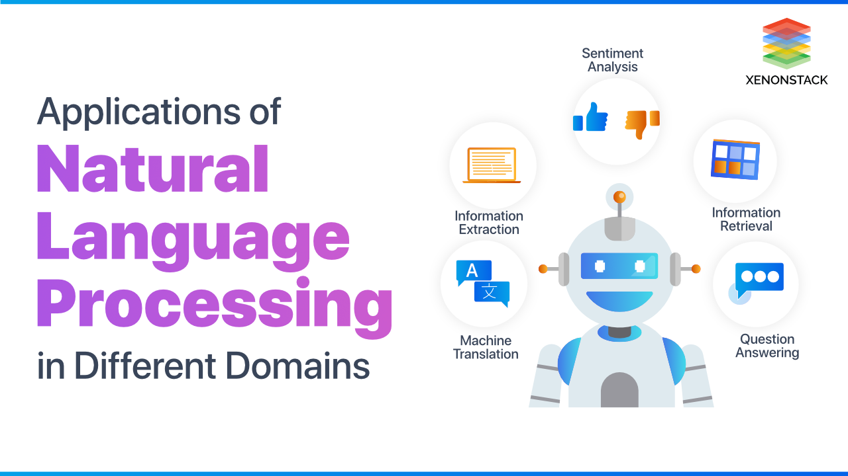
https://www.analyticsvidhya.com/blog/2021/06/text-preprocessing-in-nlp-with-python-codes/#h-sms-spam-data-for-text-preprocessing

Slide 5
Cont ..
Take sentiment analysis, for example, which uses natural language processing to detect emotions in text. This classification task is one of the most popular tasks of NLP, often used by businesses to automatically detect brand sentiment on social media.
Analyzing these interactions can help brands detect urgent customer issues that they need to respond to right away, or monitor overall customer satisfaction.

Slide 6
Why Is Natural Language Processing Important?
One of the main reasons natural language processing is so critical to businesses is that it can be used to analyze large volumes of text data, like social media comments, customer support tickets, online reviews, news reports, and more.
All this business data contains a wealth of valuable insights, and NLP can quickly help businesses discover what those insights are.
It does this by helping machines make sense of human language in a faster, more accurate, and more consistent way than human agents.

Slide 7
Cont ..
NLP tools process data in real time, 24/7, and apply the same criteria to all your data, so you can ensure the results you receive are accurate and not riddled with inconsistencies.
Once NLP tools can understand what a piece of text is about, and even measure things like sentiment, businesses can start to prioritize and organize their data in a way that suits their needs.

Slide 8
Challenges of NLP
There are many challenges in natural language processing, the benefits of NLP for businesses are huge making NLP a worthwhile investment.
However, it’s important to know what those challenges are before getting started with NLP.
Human language is complex, ambiguous, disorganized, and diverse. There are more than 6,500 languages in the world, all of them with their own syntactic and semantic rules.

Slide 9
Cont ..
Even humans struggle to make sense of language.
So for machines to understand natural language, it first needs to be transformed into something that they can interpret.
In NLP, syntax and semantic analysis are key to understanding the grammatical structure of a text and identifying how words relate to each other in a given context. But, transforming text into something machines can process is complicated.
Data scientists need to impart NLP tools to look beyond definitions and word order, to understand context, word ambiguities, and other complex concepts connected to human language.

Slide 10
How Does Natural Language Processing Work?
In natural language processing, human language is separated into fragments so that the grammatical structure of sentences and the meaning of words can be analyzed and understood in context. This helps computers read and understand spoken or written text in the same way as humans.
Here are a few fundamental NLP pre-processing tasks data scientists need to perform before NLP tools can make sense of human language:

Slide 11
Cont ..
Tokenization: breaks down text into smaller semantic units or single clauses
Part-of-speech-tagging: marking up words as nouns, verbs, adjectives, adverbs, pronouns, etc
Stemming and lemmatization: standardizing words by reducing them to their root forms
Stop word removal: filtering out common words that add little or no unique information, for example, prepositions and articles (at, to, a, the).
Only then can NLP tools transform text into something a machine can understand. The next step is to build an NLP algorithm.

Slide 12
Natural Language Processing Algorithms
Once your data has been pre-processed, it’s time to move onto the next step: building an NLP algorithm, and training it so it can interpret natural language and perform specific tasks.
There are two main algorithms you can use to solve NLP problems:
A rule-based approach. Rule-based systems rely on hand-crafted grammatical rules that need to be created by experts in linguistics, or knowledge engineers. This was the earliest approach to crafting NLP algorithms, and it’s still used today.
Machine learning algorithms. Machine learning models, on the other hand, are based on statistical methods and learn to perform tasks after being fed examples (training data).
The biggest advantage of machine learning algorithms is their ability to learn on their own. You don’t need to define manual rules instead machines learn from previous data to make predictions on their own, allowing for more flexibility.

Slide 13
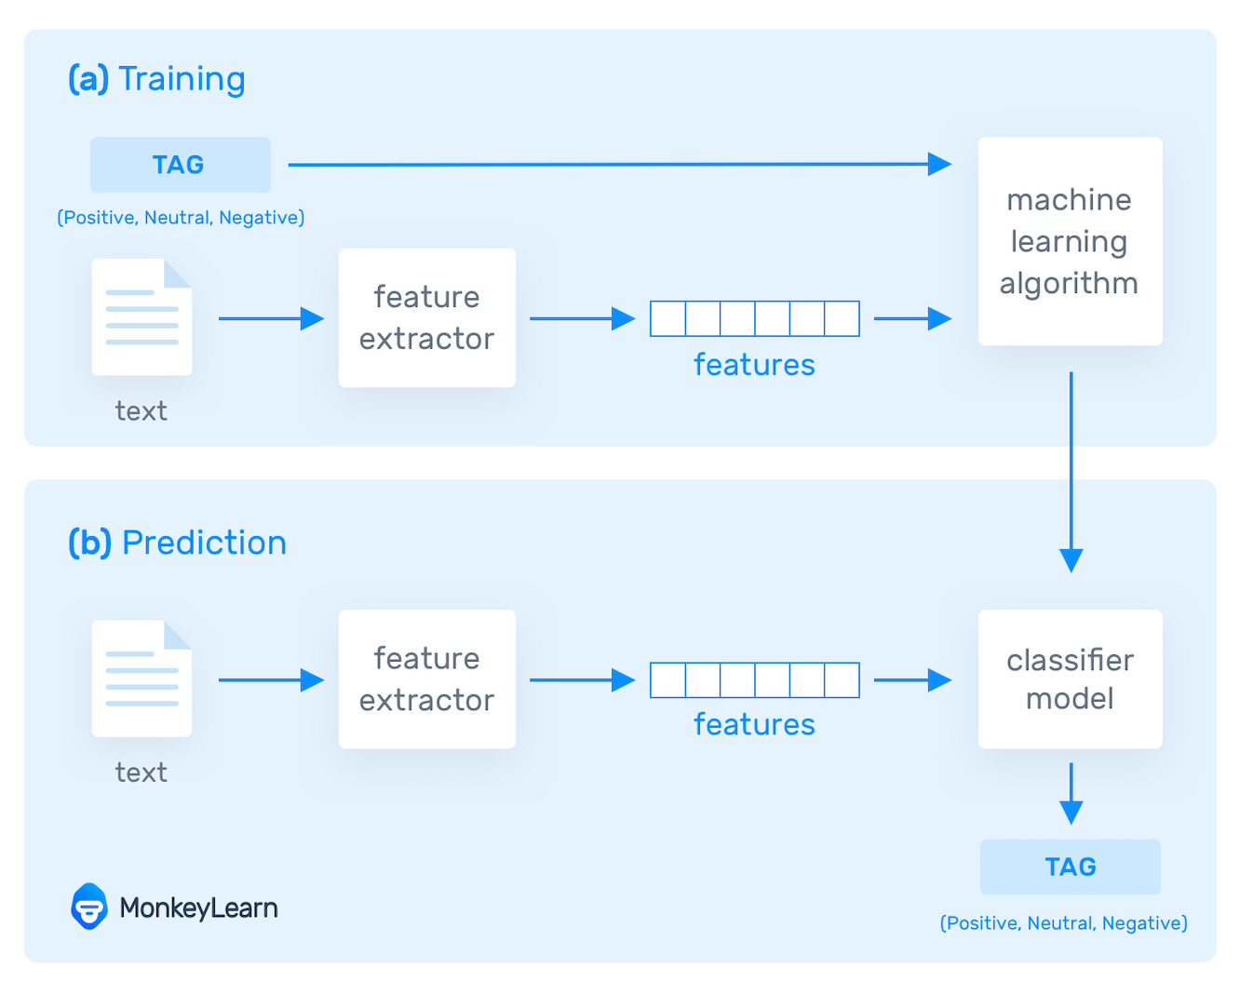

Slide 14
Natural Language Processing Examples
Natural Language Processing enables you to perform a variety of tasks, from classifying text and extracting relevant pieces of data, to translating text from one language to another and summarizing long pieces of content.

Slide 15
Cont ..
Text classification is one of the most basic NLP tasks and consists of assigning categories (tags) to a text, based on its content. Classification models can serve different purposes, for example: Sentiment Analysis.
Sentiment analysis is the process of analyzing emotions within a text and classifying them as positive, negative, or neutral. By running sentiment analysis on social media posts, product reviews, and customer feedback, businesses can gain valuable insights about how customers perceive their brand. Take these Zoom customer and product reviews.

Slide 16



Slide 17
Cont ..
Equipped with natural language processing, a sentiment classifier can understand the nuance of each opinion and automatically tag the first review as Negative and the second one as Positive.
Imagine there’s a point in negative comments about your brand on social media; sentiment analysis tools would be able to detect this immediately so you can take action before a bigger problem arises.

Slide 18
Topic Classification
Topic classification consists of identifying the main themes or topics within a text and assigning predefined tags. For training your topic classifier, you’ll need to be familiar with the data you’re analyzing, so you can define relevant categories.
For example, you might work for a software company, and receive a lot of customer support tickets that mention technical issues, usability, and feature requests. In this case, you might define your tags as Bugs or Feature Requests.

Slide 19
Cont ..
Intent detection consists of identifying the purpose, goal, or intention behind a text. It’s an excellent way of sorting outbound sales email responses by Interested, Need Information, Unsubscribe, Bounce, etc.
The tag Interested could help you spot a potential sale opportunity as soon as an email enters your inbox!

Slide 20
Text Extraction
Another example of NLP is Text Extraction, which consists of pulling out specific pieces of data that are already present in a text.
It’s a perfect way to automatically summarize text or find key information. The most common examples of extraction models are:
Keyword extraction automatically extracts the most important words and expressions within a text.
This can provide you with a sort of preview of the content and its main topics, without needing to read each piece.

Slide 21
Components of NLP
There are the following two components of NLP -
Natural Language Understanding (NLU).
Natural Language Generation (NLG)
Natural Language Understanding (NLU) helps the machine to understand and analyse human language by extracting the metadata from content such as concepts, entities, keywords, emotion, relations, and semantic roles.

Slide 22
Cont ..
NLU mainly used in Business applications to understand the customer's problem in both spoken and written language.
NLU involves the following tasks -
It is used to map the given input into useful representation.
It is used to analyze different aspects of the language.

Slide 23
Natural Language Generation
Natural Language Generation (NLG) acts as a translator that converts the computerized data into natural language representation. It mainly involves Text planning, Sentence planning, and Text Realization.
NLU | NLG
NLU is the process of reading and interpreting language. | NLG is the process of writing or generating language.
It produces non-linguistic outputs from natural language inputs. | It produces constructing natural language outputs from non-linguistic inputs.

Slide 24
Applications of NLP

Slide 25
Cont ..

Slide 27


Slide 30
NLP Tools
IBM Watson -- A pioneer AI platform for businesses
Google Cloud NLP API -- Google technology applied to NLP
Amazon Comprehend -- An AWS service to get insights from text
NLTK -- The most popular Python library
TextBlob -- An intuitive interface for NLTK
SpaCy -- Super-fast library for advanced NLP tasks

Slide 31
How to build an NLP pipeline
There are the following steps to build an NLP pipeline
Step1: Sentence Segmentation
Step2: Word Tokenization
Step3: Stemming
Step 4: Lemmatization
Step 5: Identifying Stop Words
Step 6: Dependency Parsing
Step 7: POS tags
Step 8: Named Entity Recognition (NER)
Step 9: Chunking
Ref: https://www.javatpoint.com/nlp

Slide 32
Differences between
Natural language and Computer Language
Natural Language | Computer Language
Natural language has a very large vocabulary. | Computer language has a very limited vocabulary.
Natural language is easily understood by humans. | Computer language is easily understood by the machines.
Natural language is ambiguous in nature. | Computer language is unambiguous.

Slide 33
Simple Predictive Modelling
Predictive modeling is used to determine a certain output using historical data. For example, you can build a recommendation system that calculates the likelihood of developing a disease, such as diabetes, using some clinical & personal data such as:
Age
Gender
Weight
Average glucose level
Daily calories
This way, doctors are better prepared to intervene with medications or recommend a healthier lifestyle.

Slide 34
Cont ..
Another use case for predictive models is forecasting sales. Using time series analysis, you can collect and analyze a company’s performance to estimate what kind of growth you can expect in the future.
Essentially, with predictive programming, you collect historical data, analyze it, and train a model that detects specific patterns so that when it encounters new data later on, it’s able to predict future results.
There are different predictive models that you can build using different algorithms. Popular choices include regressions, neural networks, decision trees, K-means clustering, Naïve Bayes, and others.

Slide 36
Predictive Modelling Applications
There are many ways to apply predictive models in the real world. Most industries use predictive programming either to detect the cause of a problem or to improve future results. Applications include but are not limited to:
Fraud detection
Sales forecasting
Natural disaster relief
Business performance growth
Speech recognition
News categorization
Vehicle maintenance

Slide 37
What is Sentiment Analysis
(Opinion Mining)?
Sentiment Analysis is the automated process to analyze a text and interpret the sentiments behind it. Through machine learning and text analytics, algorithms can classify statements as positive, negative, and neutral.
Sentiment Analysis, also known as “Opinion Mining,” is often used by companies and brands as a strategy for social media monitoring to manage large amounts of data and gain consumer insights to learn more about customers’ sentiment and competitors.

Slide 38
Cont ..
Sentiment analysis systems help organizations gather insights from unorganized and unstructured text that comes from online sources such as emails, blog posts, support tickets, web chats, social media channels, forums and comments.
Algorithms replace manual data processing by implementing rule-based, machine learning techniques or hybrid methods.
In addition to identifying sentiment, opinion mining can extract the polarity (or the amount of positivity and negativity), subject and opinion holder within the text. Furthermore, sentiment analysis can be applied to varying scopes such as document, paragraph, sentence and sub-sentence levels.

Slide 39
Sentiment Analysis Steps

Slide 40
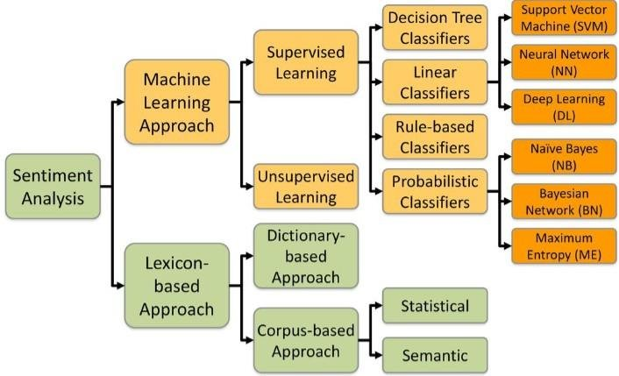
Sentiment Classification Techniques

Slide 41
Types of Sentiment Analysis
Fine-grained sentiment analysis provides a more precise level of polarity by breaking it down into further categories, usually very positive to very negative. This can be considered the opinion equivalent of ratings on a 5-star scale.
Emotion detection identifies specific emotions rather than positivity and negativity. Examples could include happiness, frustration, shock, anger and sadness.

Slide 42
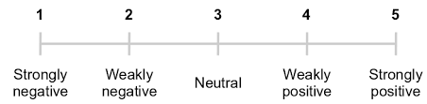
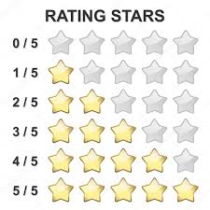
Fine-grained sentiment analysis

Slide 43
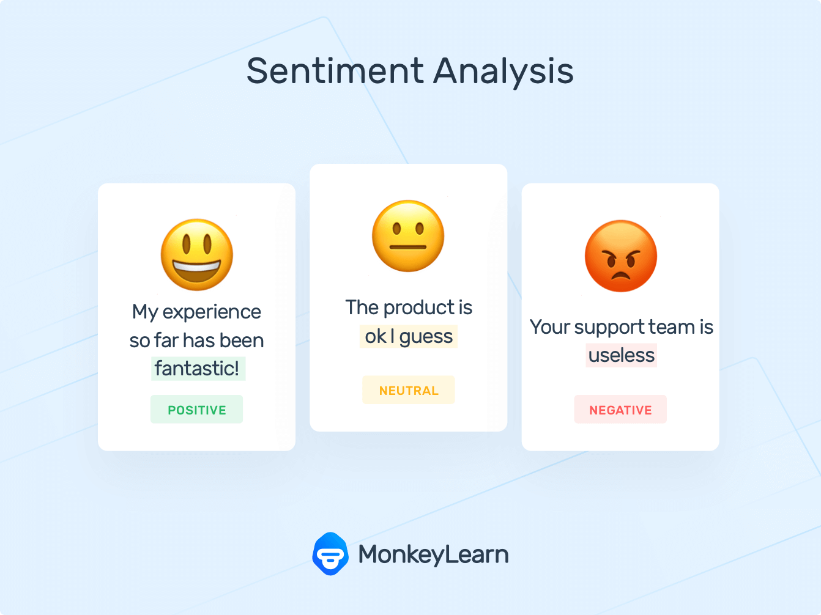
Emotion Detection Example

Slide 44
Cont ..
3. Intent-based analysis recognizes actions behind a text in addition to opinion. For example, an online comment expressing frustration about changing a battery could prompt customer service to reach out to resolve that specific issue.
4. Aspect-based analysis gathers the specific component being positively or negatively mentioned. For example, a customer might leave a review on a product saying the battery life was too short. Then, the system will return that the negative sentiment is not about the product as a whole, but about the battery life.

Slide 45
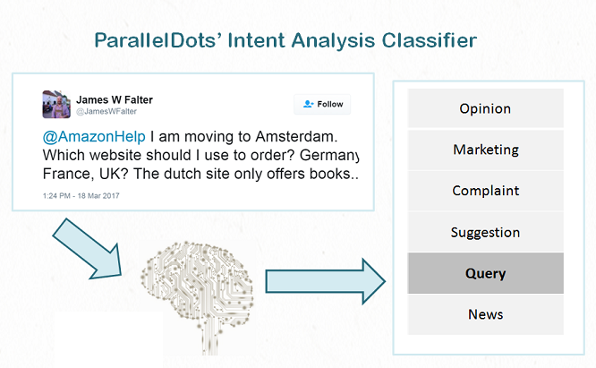
Intent-based analysis Example

Slide 46
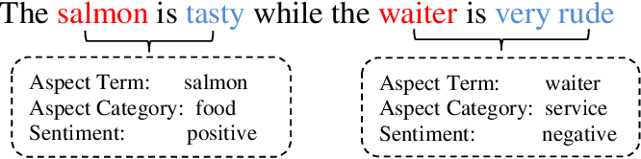
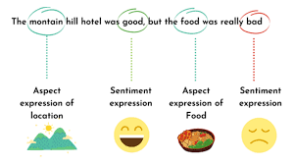
Aspect-based analysis Examples

Slide 47
Sentiment Prediction
https://monkeylearn.com/sentiment-analysis/#sentiment-analysis-algorithms

Slide 48
Applications of Sentiment Analysis
The most popular applications of sentiment analysis:
Social media monitoring
Customer support ticket analysis
Brand monitoring and reputation management
Listen to voice of the customer (VoC)
Listen to voice of the employee
Product analysis
Market research and competitive research
https://www.datasciencecentral.com/application-of-sentiment-analysis/
https://monkeylearn.com/blog/sentiment-analysis-applications/

